Slide 1
Ad VANTAGE JUN ZHANG
MOBILE AD
Monetization
optimizer

Slide 2


Objective
Allow mobile apps to predict the revenue of the next ad it will receive from an ad source.
Mobile
App Ad

Slide 3
How do Mobile Apps get ads?
Mobile App
AD Vantage
predicts:
Ad REVENUE
NOW
$0.01 Per Click
$1.00 Per Click
$0.50 Per Click
Ad Source 1
Ad Source 2
Ad Source 3

Slide 4
Process Overview
Vectorization:
Categorical
Feature Vectors
Classifications:
Random Forest
One-vs-All
Logistics
Naïve Bayes
Grid Search
Data:
Ad tags
EDA
Multi-Classification Target
Feature Importance:
Random Forest
5 Classes of Predicted Revenue
Bucket 1 | Bucket 2 | Bucket 3 | Bucket 4 | Bucket 5
y >= $ 0.04 | $0.04 >= y > $0.025 | $0.025 >= y > $0.007 | $0.007 > = y > $0.005 | y <= $0.005

Slide 5
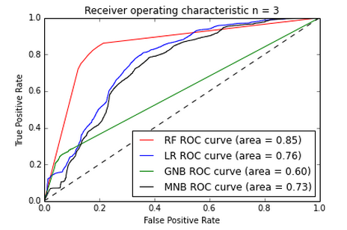
ROC Plot
Random Forest: 79% accuracy. Optimal trees=8.
0.005
0.007
0.025
0.04
5 Classes of Predicted Revenue
Bucket 1 | Bucket 2 | Bucket 3 | Bucket 4 | Bucket 5
y >= $ 0.04 | $0.04 >= y > $0.025 | $0.025 >= y > $0.007 | $0.007 > = y > $0.005 | y <= $0.005

Slide 6
Cross-Validation
 | Random Forest Confusion Matrix
 | 5 Classes of Predicted Revenue
 | Bucket 1 | Bucket 2 | Bucket 3 | Bucket 4 | Bucket 5
Actual Revenue | y >= $ 0.04 | $0.04 >= y > $0.025 | $0.025 >= y > $0.007 | $0.007 > = y > $0.005 | y <= $0.005
Bucket 1 | 3840 | 141 | 645 | 49 | 191
Bucket 2 | 137 | 1573 | 384 | 134 | 85
Bucket 3 | 735 | 445 | 4817 | 85 | 694
Bucket 4 | 52 | 148 | 98 | 2413 | 0
Bucket 5 | 220 | 71 | 778 | 0 | 6844
 | F1 Scores from Random Forest
 | Bucket 1 | Bucket 2 | Bucket 3 | Bucket 4 | Bucket 5
 | 0.77969543 | 0.67064592 | 0.71373537 | 0.89502967 | 0.87035035

Slide 7
Next Steps
More data and more time, more magic:
A/B testing, revenue lift.
More device history:
Use Device ID to create user session feature.
Establish user history to form behavior pattern.
Improve accuracy, more granular preprocessing.
Combine models.

Slide 8
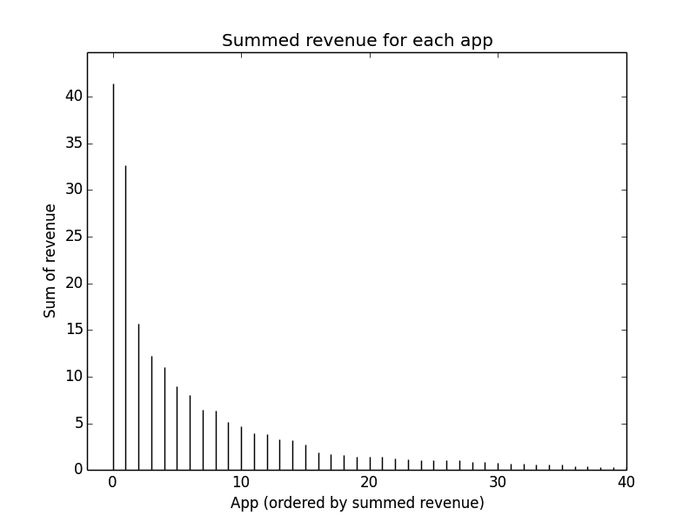
Next Steps
Most importantly, Core Revenue Segment:
Location, App, Device.
80% Total
Revenue

Slide 9
Ad VANTAGE JUN ZHANG
MOBILE AD
Monetization
optimizer

